Slide 1
Graduate Programmes in Lille
Top-level research-driven training
around the
strategic priorities of
the University of Lille

Slide 2
ULille : an international university focused on the transitions of our time,
at the heart of the Hauts de France region
A strategy organized around four societal challenges (“hubs”) :
Precision Health
Science for a Changing Planet
Human-friendly digital world
Changing Cultures, Societies and practices
- Societal challenges require interdisciplinary approaches
- Research and innovation do not know about borders
- The needs of society must be taken into account

Slide 3
A new ambition for training in Lille:
The graduate programmes
Around the 4 strategic themes of ULille, train high-level researchers or managers able to work on groundbreaking collaborative projects in the academic or socio-economic world, connected with research at the highest level, with an expertise at the state of the art.
Encourage students to explore the scientific, geographical and professional worlds around them to give their best.
Gather master and PhD students from complementary disciplines around a common theme corresponding to the challenges they want to tackle to:
make them become the experts of tomorrow,
give them a broader view of the challenges they will address.

Slide 4
3 KEY PRINCIPLES
Interdisciplinarity
International experience
Successful career planning
The objectives of the
Graduate Programmes
Bring together research, training and innovation in the context of the 4 hubs of ULille, connecting master and PhD students
Teach students interdisciplinary thinking, by having them interact today with future experts from other fields, with whom they will work tomorrow
Give students a real international outlook and improve the international attractiveness of the courses involved in GPs
Help students in their professional project and encouraging their integration into the professional world

Slide 5
Each graduate programme offers
3 KEY PRINCIPLES
Interdisciplinarity
International experience
Successful career planning
Master Courses taught in English for the GPs PH, SCP, and IKS;
in French or English for GP CCSP.
Participation in interdisciplinary events bringing together all the students of the programme, giving a global view of the thematic field
Grants to help students fund their studies and international mobility
Seminars/Afterwork events along the year to share experience and meet together
Specific training focusing on transversal skills
Topical courses by international experts

Slide 6
What is in a graduate programme?
Gather complementary expertises to build a digital world for humans and to tackle its challenges along a master-PhD continuum (common conferences, seminars,...)
M1
Master complexity with innovative conceptual tools
Design disruptive technologies
Humanise the digital society
IoT and Cyber-security
E-TECH Emergent Technologies
Physics of the 21st Century
Life Sciences and Technologies
Neurocognitive processes and affective sciences
Cognitive Sciences for Business purposes
Philosophie
Data Science
Mathematics
Mathematics
Mathematics and applications
IoT and Cyber-security
Mathematics and applications
M2
IoT and Cyber-security
E-TECH Emergent Technologies
Photonics, Complex & Quantum Systems
Life Sciences and Technologies
Neurocognitive processes and affective sciences
Cognitive Sciences for Business purposes
Contemporary philosophy
Data Science
Mathematics - Research
Mathematics
Scientific Computing
IoT and Cyber-Security
Mathematics and applications
PhD
MADIS
ENGSYS
SMRE
SHS
Any thesis project relevant to the digital world and its challenges is welcome in the programme

Slide 7
3 KEY PRINCIPLES
Interdisciplinarity
International experience
Successful career planning
Added value of graduate programmes
Outstanding scientific environment, with top-level research units and cutting-edge equipments
Reinforced welcome and support for international students
Reinforced professional training, links with the socio-economic world
"Graduate Programme" label in the diploma supplement for master and doctoral students

Slide 8
Graduate programme
Information and Knowledge Society
Head : Marc Lefranc,
Project manager : Maéna Martin-Ladakis

Slide 9
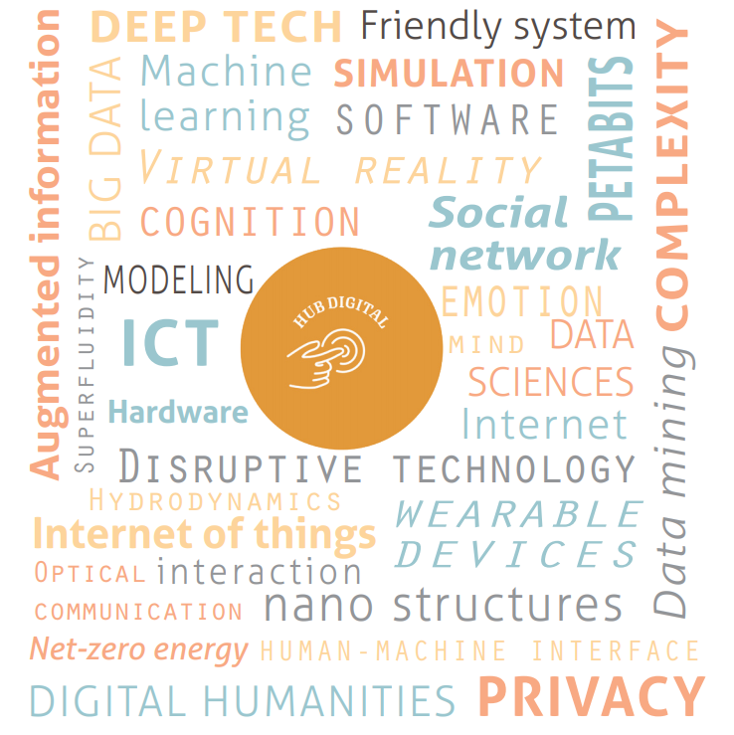
Context: towards a human-friendly digital world
In our modern societies, information has never been so easy to produce, transport and share, fostering the creation of new knowledge.
We are experiencing a transition to a massively connected world, where everyone can be reached everywhere at any time.
Massive amounts of data gives us unprecedented insight into the dynamics of the world around us.
Making the digital world friendly to humans and giving sense to it are outstanding challenges.
The Graduate Programme “Information and Knowledge Society” prepares its students to build together the digital world of tomorrow, and to tackle the three following challenges:
Humanise the digital world
Master complexity with innovative conceptual tools
Design disruptive technologies for friendly devices

Slide 10
Le Graduate Programme IKS
Gather complementary expertises to build a digital world for humans and to tackle its challenges along a master-PhD continuum (common conferences, seminars,...)
Foreign students >30%
CMA : compétences et métiers d'avenir
M1
Master complexity with innovative conceptual tools
Design disruptive technologies
Humanise the digital society
IoT and Cyber-security
E-TECH Emergent Technologies
Life Sciences and Technologies
Phys. Fondamentale/Physics of the 21st Century
Neuro-cognitive processes and affective sciences
Cognitive Sciences for Business purposes
Contemporary philosophy
Data Science
Mathematics
Mathematics
Mathematics and applications
IoT and Cyber-security
Mathematics and applications
M2
12
18
17
13
8
22
12
20
16
7
IoT and Cyber-security
E-TECH Emergent Technologies
Life Sciences and Technologies
Photonics, Complex & Quantum Systems
Neuro-cognitive processes and affective sciences
Cognitive Sciences for Business purposes
Contemporary philosophy
Data Science
Mathematics - Research
Mathematics
Scientific Computing
IoT and Cyber-Security
Mathematics and applications
CMA
CMA
PhD
14
12
13
8
12
7
10
24
15
5
MADIS
ENGSYS
SMRE
SHS
28
14
12
2
Total: 133 M1 (43 foreign) + 120 M2 (25 foreign) = 253 master students (68 foreign; 26%)
55 PhD students (with ~ 40 first year students coming)
Applying: International Master in Robotics and Transport (Polytech, Centrale Lille).

Slide 11
IKS days (october 4-5):
An interdisciplinariy meeting
Presentation of the master tracks by the students
Trustful image processing with machine learning (data science)
Vortex nucleation in cold atoms(physics and mathematics)
Flash poster presentation by PhD students from all research units
And the number became word: ethics of generative AI (artificial intelligence, philosophy) by Alexei Grinbaum
Nanotechnology approaches in wound healing (nanotechnology, biology)
Recent trends in human face and body generation (computer science, human/machine interface)
Complex dynamics of cancer heterogeneity: towards new therapeutic strategies (modeling&simulation, biology)
Autonomous robotics: from a monolithic to large-scale systems (robotics, automation)
Presentation of the main technological platforms of Ulille
Pursuing a PhD, during and after.
International mobility
Methods and tools for tactile and gesture-based interaction (electronics, computer science, human/machine interaction)
Quantum information and technologies: what can we do with them? (physics, mathematics, computer science,...)

Slide 12
2023-2024 IKS events
04-05/10/2023 : IKS annual days over two full days at LILLIAD
08/11/2023: Collective delusions on social networks? Reflections from the case of morgellons (Philosophy)
06/12/2023: round table on “Decision making in an uncertain environment” (scientific computing, image processing, system biology, real-time software systems, machine learning, data science)
24/01/2024: Morphogenesis, how do structures appear? (mathematics, nanotechnology, cognitive sciences, biology, etc.)
21/02/2024: Feedback loops and complexity (physics, cognitive sciences, biology, micro-electronics, mathematics,...)
20/03/2024: Generative artificial intelligence: ChatGPT, DALL-E, … (everybody)
15/05/2024: end seminar, melting pot.

Slide 13
Benefits for PHD students
Interdisciplinary meetings (IKS days + monthy afterwork sessions) :
Meet master and Phd students with complementary expertises and discuss about outstanding questions related to a human-friendly digital worlds
Explain your research to master students and help them to consider pursuing a PhD thesis
Strenghten your skills in communicating about your work, perhaps in organizing common activities
Mobility grants: Receive up to 3000 € for a stay abroad (900 € for the first 4 weeks et 150 €/week for the 14 remaining ones).
With your PhD diploma, receive a certificate attesting of your participation in the Graduate Programme.

Slide 14
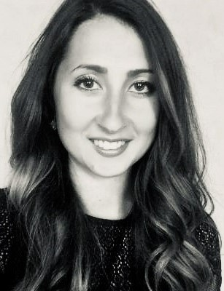
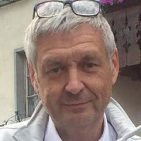
More information
Maéna MARTIN-LADAKIS
Project Manager
Marc Lefranc
Prof. Université de Lille
Coordinator
e-mail: graduate-programme-iks@univ-lille.fr
e-mail: resp-graduate-programme-iks@univ-lille.fr
international.univ-lille.fr/graduate-programmes

